Slide 1
KWIC INDEX SYSTEM
CS/SE 6362 - ADVANCED SOFTWARE ARCHITECTURE AND DESIGN
FALL 2015
Notes:
team is to architect a simple KWIC software system and implement it, which later will be used for a web search engine
Task is to build a contextualized index for the text

Slide 2
TEAM - $QUICK SEARCH
Sruthi Chappidi
Barbara Maweu
Maryellen Oltman
Twinkle Sharma

Slide 3
TABLE OF CONTENTS
System Requirements
Problem Statement
Specifications
Functional Requirements
Non-Functional Requirements
Design
Architectural Design
Implementation
Test Plan
Summary

Slide 4
REQUIREMENTS
Accept an ordered input of lines, words and characters from the user. The sets of lines are delimited by the $ symbol. The sets of words are delimited by a single space. All character values are supported and delimited by the ASCII character set.
After the input has been given, the user will select an action that enables the program to perform the functions of the KWIC system.
The KWIC system is to read in the input and generate an ordered list of circularly shifted lines, by removing the first word in the line and appending it to the end of the line.
The circularly shifted lines are then sorted in increasing order based on the character alphabet precedence.
The system has pre-defined set of noise words, against which the circularly shifted lines are compared. The KWIC system will eliminate circularly shifted lines starting with these noise words.

Slide 5
PROBLEM STATEMENT
The problem of | Not having a search engine that outputs an indexed search that is generated from user input (list of strings)
affects | users of the search engine
the impact of which is | unrelated, unordered search engine result set.
A successful solution will be | a KWIC index search engine that accepts: an ordered set of lines the lines may be “circularly shifted” outputs a list of all circular shifts of all lines in alphabetical order.

Slide 6
PURPOSE
The purpose of our project is:
Develop KWIC Software System (Keyword In Context)
Using Java Applet
Utilizing Object Oriented Software Architecture(ADT)
Produce a system that provides a convenient search mechanism for a list of lines, such as book titles, or online documentation entries.
Notes:
Develp Architecture and implement KWIC software system

Slide 7
FUNCTIONAL REQUIREMENTS
FR1.0 – The KWIC system shall provide an input field that accepts an ordered set of lines.
FR2.0 – The KWIC system shall accept an ordered set of lines.
FR2.1 – Each ordered set of lines are an ordered set of words.
FR2.2 – Each ordered set of words are an ordered set of characters.
FR3.0 – The KWIC system shall output a listing of all circular shifted lines in ascending alphabetical order.

Slide 8
NON-FUNCTIONAL REQUIREMENTS
NFR1.0 – User-Friendly
Display should use easy to understand icons.
NFR2.0 – Modifiability
There must be separation of concern in each process modules
NFR2.0 – Enhanceable
The components of the system should be easy to enhance and update.
NFR4.0 – Performance
The overall system should minimize processing overhead
Notes:
in terms of criteria and measure

Slide 9
TRACEABILITY
NFR/FR
 | FR1.0 | FR2.0 | FR3.0
NFR1.0 | X
NFR2.0 | X | X | X
NFR3.0 | X | X | X
NFR4.0 | X | X | X

Slide 10
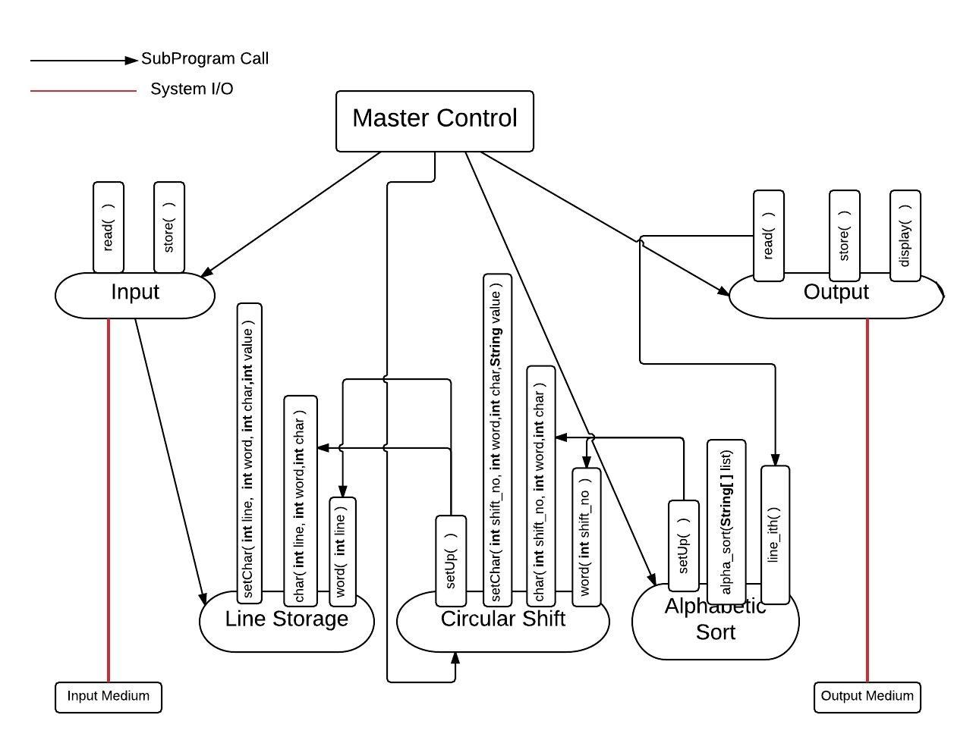
ARCHITECTURAL DESIGN
ABSTRACT DATA TYPE MODEL(ADT)
Design 1

Slide 11
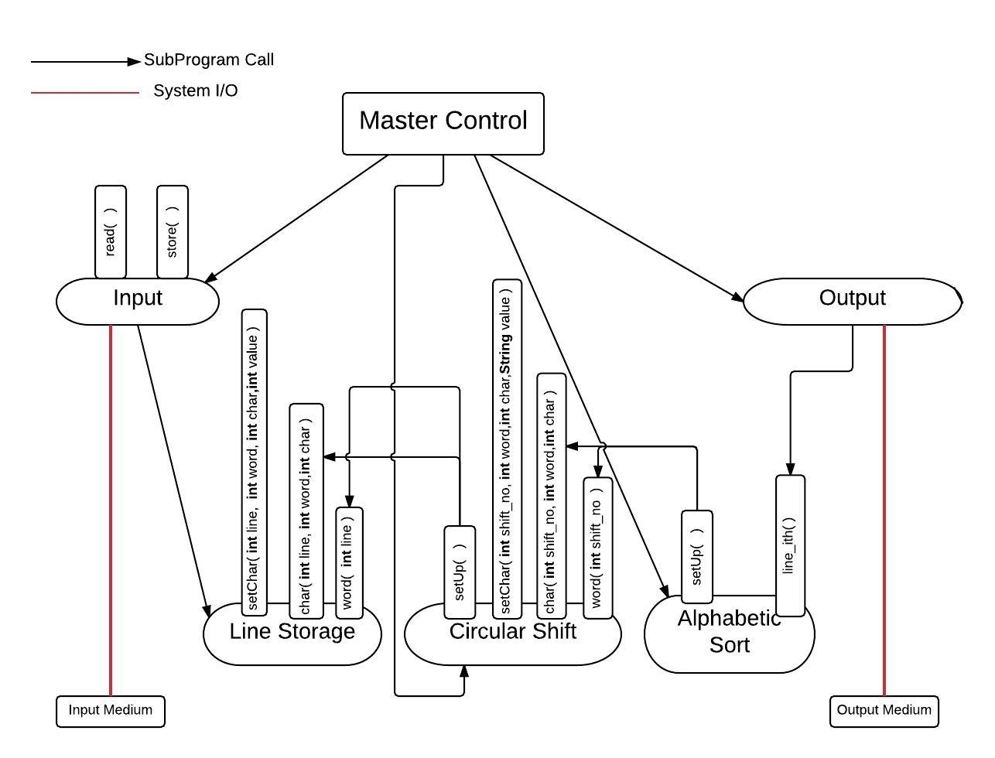
ALTERNATIVE ARCHITECTURAL DESIGN
ABSTRACT DATA TYPE MODEL(ADT)
Design2

Slide 12
TRADEOFF ANALYSIS
 | Design1 | Design2
Modifiability [algorithm] | + | +-
Modifiability [data structure] | + | +
Enhanceability | ++ | +-
Reusability | + | +
Performance | -- | --
Uniformity | ++ | -+
Rationale | uniformity of interfaces which will make the design highly understandable.

Slide 13
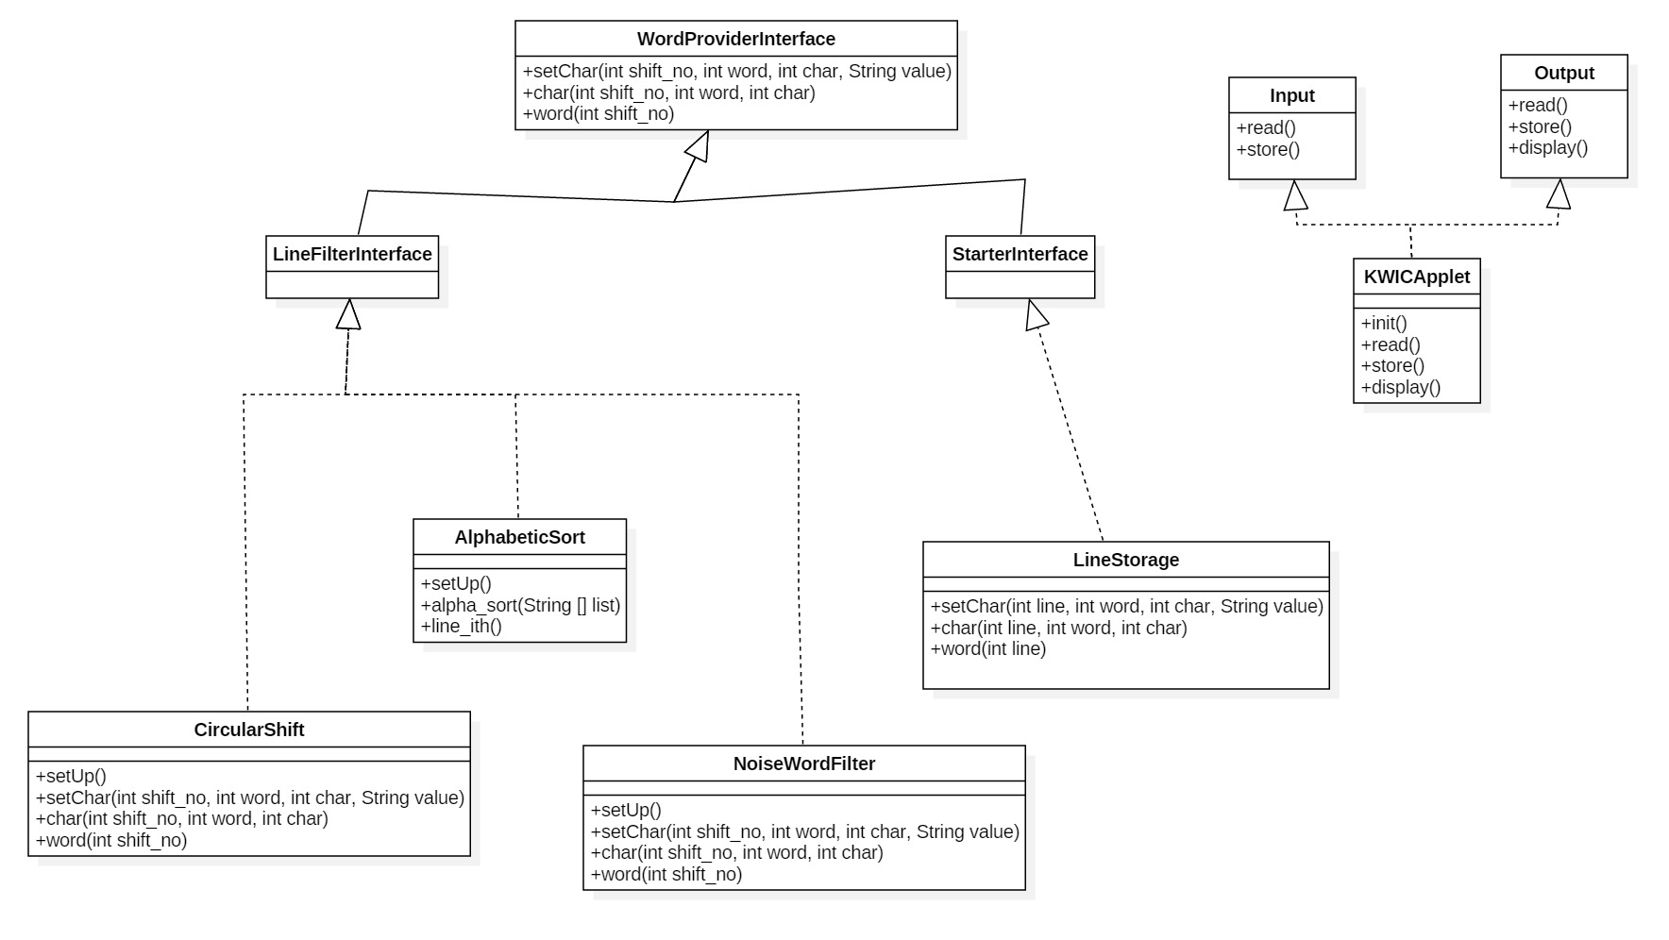
KWIC CLASS DIAGRAM

Slide 14
ARCHITECTURAL RATIONALE
Abstraction and Encapsulation – ADT
Implementation of Interface
Advantages of ADT
Reusability
Portability
Robustness
Maintainability
Advantages of UML
Understandability

Slide 15
IMPLEMENTATION/ PROTOTYPE
Java
Web application
Internet Access
Prototype:
http://www.utdallas.edu/~maryellen.oltman/
example input:
Please enter some lines$With a dollar sign$In between each one

Slide 16
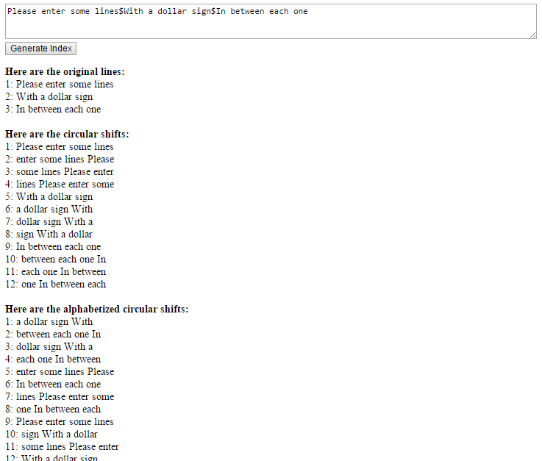
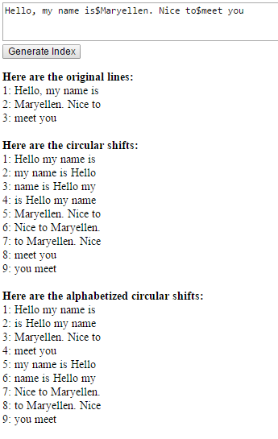
Implementation
Prototype

Slide 17
SUMMARY
What has been done
Requirements Elicited
Requirement Specification
Functional and Non -Functional Traceability
Architectural Design
Tradeoff Analysis
Implementation/ Prototype
Phase 1 Interim Deliverables: http://www.utdallas.edu/~maryellen.oltman/

Slide 18
FUTURE TASKS
What has to be done
Testing
Documentation Refinement
Enhancements
Final Deliverables

Slide 19
WHY WE ARE BEST
We are best because our system is
Easy to use - the description on the pages make it easy for the user to navigate the application.
Performance - the response time is <5 seconds for each input line.
The team has covered all the functional requirements.

Slide 20
REFERENCES
Dr. Lawrence Chung
Professor - CS/SE 6362 Advanced Software Architecture & Design – Fall 2015
Textbook
Mary Shaw & David Garlan. Software Architecture: Perspectives on an Emerging Discipline

Slide 21

QUESTIONS

